Slide 1




E commerce Data Analysis using Excel
STUDENT NAME:U.Rohith
REGISTER NO:422200020
DEPARTMENT:B.COM(ISM)
COLLEGE : S.I.V.E.T COLLEGE

Slide 2

E-COMMERCE Data analysis using Excel

Slide 3


AGENDA
Problem Statement
Project Overview
End Users
Our Solution and Proposition
Dataset Description
Modelling Approach
Results and Discussion
Conclusion
3/21/2024 Annual Review

Slide 4

PROBLEM STATEMENT
As an online retailer, I struggle to effectively manage my inventory levels, leading to frequent and overstocking, which results in lost sales, wasted resources, and decreased customer satisfaction.
Additionally, my current e-commerce platform lacks personalized product recommendations, making it difficult to increase average order value and enhance the overall shopping experience.

Slide 5

PROJECT OVERVIEW
Design and develop a user-friendly e-commerce Platform that allows customers to browse and Purchase products online.
It involves managing Many aspects of an online retail business including Website development, inventory management , Customer service, payment processing, and order fulfilment.

Slide 6

WHO ARE THE END USERS?
End-users in e-commerce are individuals or organizations who ultimately use or consume the products or services purchased through an online platform.
People buying products for personal use.
A person buying a smartphone online.
Companies purchasing products or individuals buying products to resell.

Slide 7

OUR SOLUTION AND ITS VALUE PROPOSITION
Our e-commerce platform is designed to provide a seamless and personalized shopping experience for customers.
It offers a user-friendly interface, relevant product recommendations, competitive pricing, secure payment options, and efficient delivery and returns.

Slide 8
Dataset Description
Dataset Description: This dataset contains customer transaction data for an e-commerce platform. It includes information about customers, orders, products, and payment.
Market analysis, pricing strategies, competitive benchmarking, product surveillance, sentiment tracking, and making data-driven decisions.

Slide 9

THE "WOW" IN OUR SOLUTION
There are multiple matches for “wow” in e-commerce, including a WOW factor for customers, a WOW Commerce platform, and a WOW Certified
E-Commerce Manager certificate. A “wow” factor is a way to exceed customer expectations and give them a pleasant surprise.
Amazon’s delivery sometimes arriving before the expected date is a “wow” factor that can impact a customer’s relationship with the store.
3/21/2024 Annual Review
9

Slide 10
MODELLING
Model portfolios and online booking platforms
Digital marketplaces for stock photos and videos
Online courses and tutorials for modeling techniques
E-commerce websites for fashion and beauty products
Virtual reality (VR) and augmented reality (AR) experiences
10

Slide 11
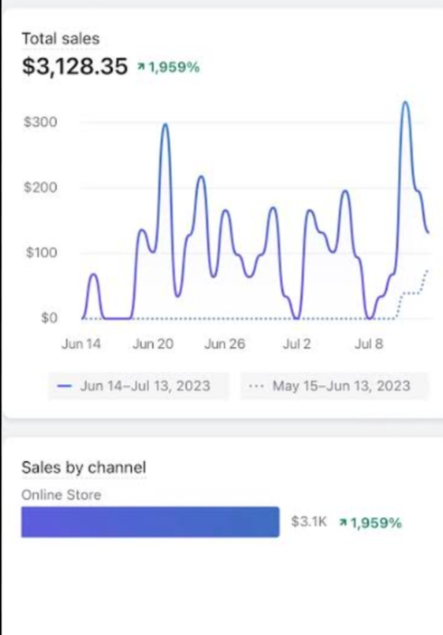
RESULTS
11

Slide 12
conclusion
The advent of e-commerce has revolutionized the way businesses operate and consumers shop. With its unprecedented growth and widespread adoption, e-commerce has transformed the retail landscape, offering unparalleled convenience, accessibility, and flexibility.

